Slide 1


Noida Institute of Engineering and Technology, Greater Noida
Object Oriented Concepts
Unit: 2
Problem Solving Using Advanced Python
Course Details
(B Tech 2nd Sem /1st Year)

Slide 2
CONTENTS
Inheritance
Types of Inheritance
Invoking the parent Class Method
Method Overriding
Abstract Class, Duck Typing
MRO & Super(), Specilization vs Generalization, Containership
Polymorphism, Method Overloading, Operator overloading
Introspection: Introspection types , Introspection objects
Introspection scopes, Inspect modules, Introspect tools

Slide 3
COURSE OBJECTIVES
After you have read and studied this module, you should be able to:
To learn the Object-Oriented Concepts in Python.
To learn the concept of reusability through inheritance polymorphism and Introspection tools.
To impart the knowledge of functional programming.
To learn the concepts of designing graphical user interfaces. To explore the knowledge of standard Python libraries.

Slide 4
COURSE OUTCOME
Course Outcome ( CO) | At the end of course , the student will be able : | Bloom’s Knowledge Level (KL)
CO1 | Define classes and create instances in python. | K1, K2
CO2 | Implement concept of inheritance and polymorphism using python. | K3
CO3 | Implement functional programming in python. | K3
CO4 | Create GUI based Python application. | K2
CO5 | Apply the concept of Python libraries to solve real world problems. | K3,K6

Slide 5
CO-PO and PSO Mapping
Mapping of Course Outcomes and Program Outcomes:
 |  |  |  | Programming in Advanced Python
CO | PO1 | PO2 | PO3 |  | PO4 | PO5 | PO6 | PO7 | PO | PO9 | PO10 | PO11 | PO12
CO1 | 3 | 3 | 3 |  | 3 | 2 | 2 | 1 | - | 1 | - | 2 | 2
CO2 | 3 | 3 | 3 |  | 3 | 2 | 2 | 1 | - | 1 | 1 | 2 | 2
CO3 | 3 | 3 | 3 |  | 3 | 3 | 2 | 2 | - | 2 | 1 | 2 | 3
CO4 | 3 | 3 | 3 |  | 3 | 3 | 2 | 2 | 1 | 2 | 1 | 2 | 3
CO5 | 3 | 3 | 3 |  | 3 | 3 | 2 | 2 | 1 | 2 | 1 | 2 | 2
Average | 3 | 3 | 3 |  | 3 | 2.6 | 2 | 1.6 | 0.4 | 1.6 | 0.8 | 2 | 2.2
Mapping of Course Outcomes and Program Specific Outcomes
Programming in Advanced Python
CO.K | PSO1 | PSO2 | PSO3 | PSO4
CO1 | 2 | 3 | 2 | 2
CO2 | 2 | 3 | 2 | 2
CO3 | 2 | 3 | 3 | 3
CO4 | 3 | 3 | 3 | 3
CO5 | 3 | 3 | 3 | 3
Average | 2.4 | 5 | 2.6 | 2.6

Slide 6
Prerequisite and Recap(CO2)
Operators
Loop
Method
Variables
Class , Objects
Constructor

Slide 7
Topic Objectives(CO2)
After you have read and studied this topic, you should be able to:
  Understand the concept of Object-Oriented Systems.
  Create class and objects.
  Understand the concept of Inheritance and its types.
  Able to know about Constructor.

Slide 8
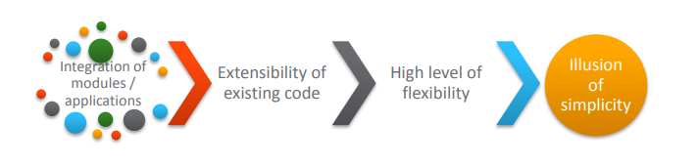
Need for Object Oriented Approach (CO2)
Challenges in developing a business application.
If these challenges are not addressed, it may lead to software crisis.

Slide 9

Need for Object Oriented Approach (CO2)
Features needed in the business application to meet these challenges.
Challenges can be addressed using object-oriented approach.

Slide 10
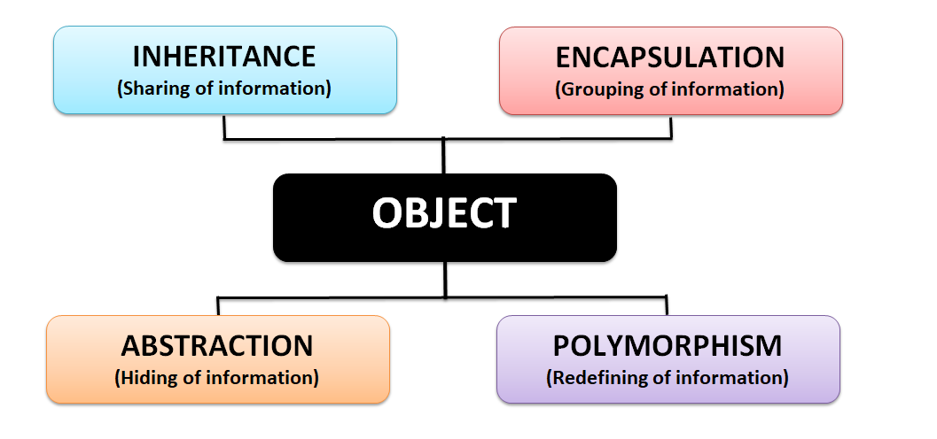
Pillars of OOPS (CO2)

Slide 11

Inheritance (CO2)

Slide 12
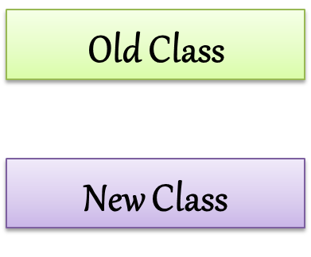
Inheritance (CO2)
The mechanism of deriving a new class from an old one (existing class) such that the new class inherit all the members (variables and methods) of old class is called inheritance or derivation.
Parent class is the class being inherited from, also called base class.
Child class is the class that inherits from another class, also called derived class.

Slide 13
Super Class and Sub Class (CO2)
The old class is referred to as the Super class and the new one is called the Sub class.
Parent Class - Base Class or Super Class
Child Class - Derived Class or Sub Class
Father
Home
Money
Business
Parent Class
Child Class
Son
BMW
Job

Slide 14
Advantage of Inheritance (CO2)
All classes in python are built from a single super class called ‘object’ so whenever we create a class in python, object will become super class for them internally.
The main advantage of inheritance is code reusability.
Python also allows the classes to inherit commonly used attributes and methods from other classes through inheritance.
It is transitive in nature, which means that if class B inherits from another class A, then all the subclasses of B would automatically inherit from class A.

Slide 15
Type of Inheritance (CO2)
Single Inheritance
Multi-level Inheritance
Hierarchical Inheritance
Multiple Inheritance
Hybrid Inheritance

Slide 16
Declaration of Child Class(CO2)
class ChildClassName (ParentClassName) :
members of Child class
class Mobile (object) :
members of Child class
class Mobile :
members of Child class

Slide 17
Single Inheritance(CO2)
If a class is derived from one base class (Parent Class), it is called Single Inheritance.
object
Father
Parent Class
Son
Child Class

Slide 18
Single Inheritance Syntax(CO2)
Syntax:-
class ParentClassName(object):
members of Parent Class
class ChildClassName(ParentClassName):
members of Child Class
Example:-
class Father:
members of class Father
class Son (Father):
members of class Son
Parent Class
Child Class
Father
Parent Class
Son
Child Class

Slide 19
Single Inheritance(CO2)
We can access Parent Class Variables and Methods using Child Class Object
We can also access Parent Class Variables and Methods using Parent Class Object
We can not access Child Class Variables and Methods using Parent Class Object

Slide 20
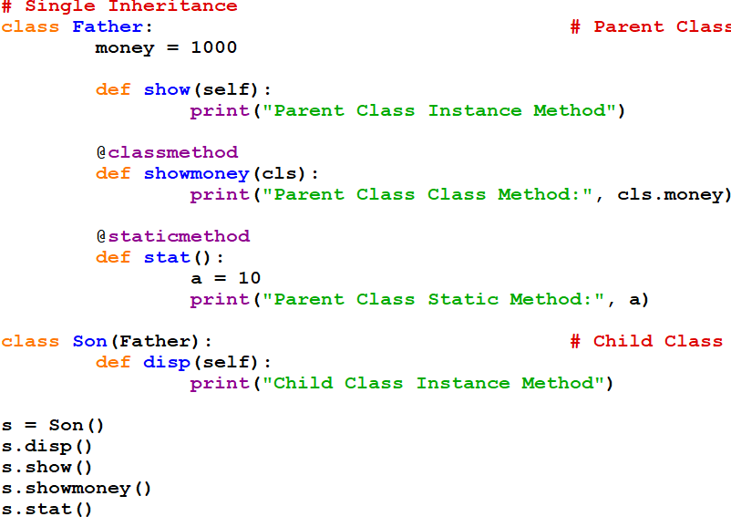
Single Inheritance Program (CO2)

Slide 21

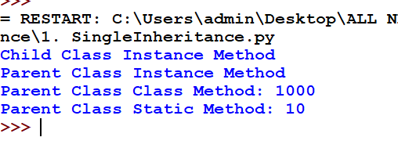
Single Inheritance Program Output (CO2)
Output

Slide 22
Daily MCQs
1.When a child class inherits from only one parent class, it is called?
A. single inheritance
B. singular inheritance
C. Multiple inheritance
D. Multilevel inheritance
Answer: A
2. Parent class is the class being inherited from, also called?
A. derived class
B. Child class
C. Hybrid class
D. base class
Answer: D
3.What is true about Inheritance in Python?
A. Inheritance is the capability of one class to derive or inherit the properties from another class.
B. It represents real-world relationships well.
C. It provides reusability of a code.
D. All of the above
Answer: D

Slide 23
Daily MCQs
4.What will be the output of below Python code?
class Student:
def __init__(self,name,id):
self.name=name
self.id=id
print(self.id)
std=Student("Simon",1)
std.id=2
print(std.id)
A. 1 1 B. 1 2 C. 2 1 D. 2 2
Answer: B
5.What type of inheritance is illustrated in the following piece of code?
class A():
pass
class B(A):
pass
class C(B):
pass
A.Multi-level inheritance
Answer: A

Slide 24
Daily MCQs
6.When defining a subclass in Python that is meant to serve as a subtype, the subtype Python keyword is used.
a) True
b) False Answer-B
7.Suppose B is a subclass of A, to invoke the __init__ method in A from B, what is the line of code you should write?
a) A.__init__(self)
b) B.__init__(self)
c) A.__init__(B)
d) B.__init__(A) Answer-A
8. Which of the following is not a type of inheritance?
a) Double-level
b) Multi-level
c) Single-level
d) Multiple Answer-A

Slide 25
Constructor Overriding(CO2)
If we write constructor in the both classes, parent class and child class then the parent class constructor is not available to the child class.
In this case only child class constructor is accessible which means child class constructor is replacing parent class constructor.
Constructor overriding is used when programmer want to modify the existing behavior of a constructor.

Slide 26
Constructor Overriding Program(CO2)
class Father:
def __init__(self):
self.money = 2000
print("Father Class Constructor")
class Son(Father):
def __init__(self):
self.money = 5000
print("Son Class Constructor")
def disp(self):
print(self.money)
s = Son()
s.disp()
How can we call parent
class constructor ?

Slide 27
Constructor with super( ) Method(CO2)
If we write constructor in the both classes, parent class and child class then the parent class constructor is not available to the child class.
In this case only child class constructor is accessible which means child class constructor is replacing parent class constructor.
super ( ) method is used to call parent class constructor or methods from the child class.

Slide 28
Daily MCQs
1. overriding means changing behavior of methods of derived class method in in base class?
A)True B)False
Answer: B
2. The child's __init__() function overrides the inheritance of the parent's __init__() function.
A. TRUE
B. FALSE
C. Can be true or false
D. Can not say
Answer: A
3. class People():
def __init__(self, name):
self.name = name
def namePrint(self):
print(self.name)
person1 = People("Sally")
person2 = People("Louise")
person1.namePrint()
A.sally B.Louise C.Sally Louise D.person1
Answer: A

Slide 29
Daily MCQs
4. The child's __init__() function overrides the inheritance of the parent's __init__() function.
A. TRUE B. FALSE C. Can be true or false D. Can not say
Answer-A
5.Which of the following statements is false?
A. A non-private method in a superclass can be overridden
B. A derived class is a subset of superclass
C. The value of a private variable in the superclass can be changed in the subclass
D. When invoking the constructor from a subclass, the constructor of superclass is automatically invoked
Answer:-C

Slide 30
Daily MCQs
6.What will be output for the folllowing code?
class A:
def __init__(self, x= 1):
self.x = x
class der(A):
def __init__(self,y = 2):
super().__init__()
self.y = y
def main():
obj = der()
print(obj.x, obj.y)
main()
A. Error, the syntax of the invoking method is wrong
B. The program runs fine but nothing is printed
C. 1 0
D. 1 2
Answer-D

Slide 31
Multi-level Inheritance(CO2)
In multi-level inheritance, the class inherits the feature of another derived class (Child Class).
object
Father
Parent Class
Son
Child Class
GrandSon
GrandChild Class

Slide 32
Multi-level Inheritance Syntax(CO2)
Syntax:-
class ParentClassName(object):
members of Parent Class
class ChildClassName(ParentClassName):
members of Child Class
class GrandChildClassName(ChildClassName):
members of Grand Child Class
object
Parent Class
Child Class
Grand Child

Slide 33
Multi-level Inheritance Example(CO2)
object
class Father (object):
members of class Father
class Son (Father):
members of class Son
class GrandSon (Son):
members of class GrandSon
Parent Class
Father
Child Class
Son
GrandChild Class
GrandSon

Slide 34
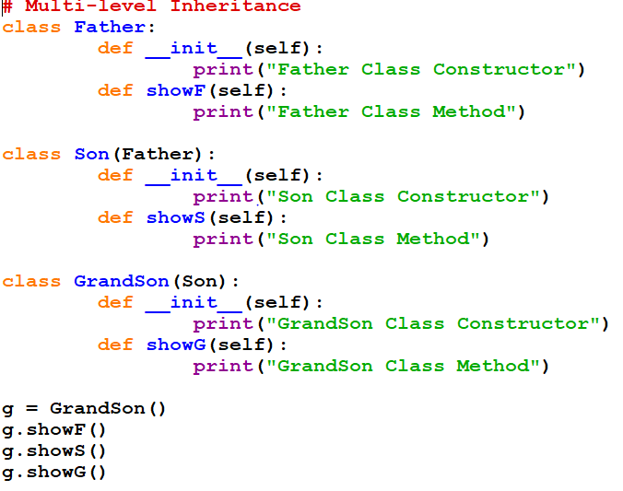
Multi-level Inheritance Program(CO2)

Slide 35
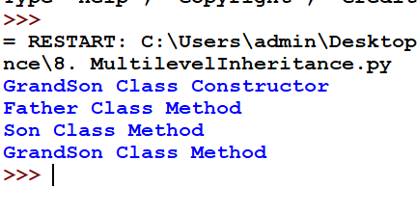
        Multi-level Inheritance Program(CO2)
OUTPUT

Slide 36
Daily MCQs
When two or more classes serve as base class for a derived class, the situation is known as __________.
multiple inheritance
polymorphism
encapsulation
hierarchical inheritance
none of these
Answer: A
2. Multiple inheritance leaves room for a derived class to have _______ members.
dynamic
private
public
ambiguous
none of these
Answer: d

Slide 37
Daily MCQs
3. If there are 5 classes, E is derived from D, D from C, C from B and B from A. Which class constructor will be called first if the object of E or D is created?
a) A
b) B
c) C
d) A and B Answer-A
4. Multilevel inheritance allows _________________ in the program.
a) Only 7 levels of inheritance
b) At least 7 levels of inheritance
c) At most 16 levels of inheritance
d) As many levels of inheritance as required Answer-D

Slide 38
Hierarchical Inheritance(CO2)
object
Father
Parent Class
Son
Daughter
Son
Child Class

Slide 39
Hierarchical Inheritance Syntax(CO2)
Syntax:-
class ParentClassName(object):
members of Parent Class
class ChildClassName1(ParentClassName):
members of Child Class 2
class ChildClassName2(ParentClassName):
members of Child Class 2
object
Parent Class
Child Class 1
Child Class 2

Slide 40
Hierarchical Inheritance(CO2)
class Father (object):
members of class Father
class Son (Father):
members of class Son
class Daughter (Father):
members of class Daughter
object
Parent Class
Father
Child Class
Son
Daughter
Child Class

Slide 41
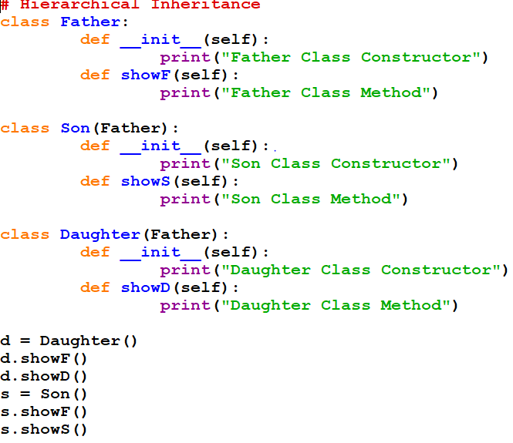
Hierarchical Inheritance Program(CO2)

Slide 42
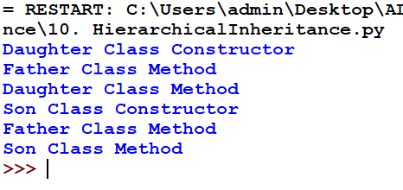
Hierarchical Inheritance Program(CO2)
OUTPUT

Slide 43
Multiple Inheritance(CO2)
If a class is derived from more than one parent class, then it is called multiple inheritance.
object
Parent Class
Parent 1
Parent 2
Parent Class
Child
Child Class

Slide 44
Multiple Inheritance Syntax(CO2)
object
Syntax:-
class ParentClassName1(object):
members of Parent Class
class ParentClassName2(object):
members of Parent Class
class ChildClassName(ParentClassName1, ParentClassName2):
members of Child Class
Parent 1
Parent 2
Child

Slide 45
Multiple Inheritance(CO2)
object
class Father (object):
members of class Father
class Mother (object):
members of class Mother
class Son (Father, Mother):
members of class Son
Parent Class
Father
Mother
Parent Class
Son
Child Class

Slide 46
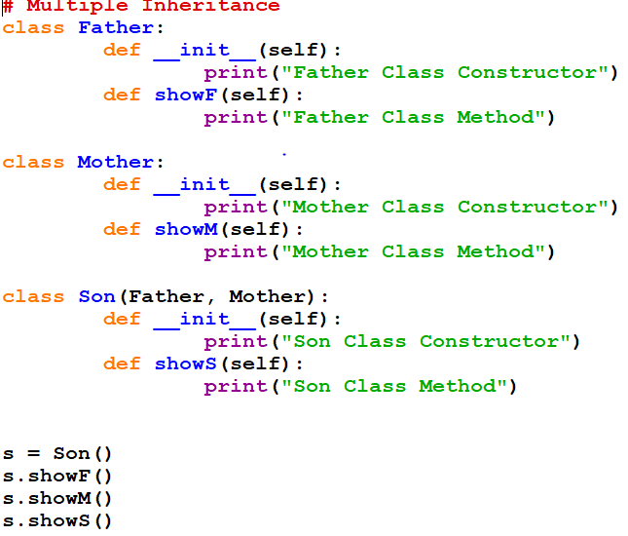
Multiple Inheritance Program(CO2)

Slide 47
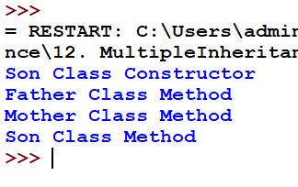
Multiple Inheritance Program(CO2)
OUTPUT

Slide 48
Daily Quiz
Which of the following best describes inheritance?
a) Ability of a class to derive members of another class as a part of its own definition.
b) Means of bundling instance variables and methods in order to restrict access to certain class members
c) Focuses on variables and passing of variables to functions
d) Allows for implementation of elegant software that is well designed and easily modified.
Answer: a
2. All subclasses are a subtype in object-oriented programming.
a) True
b) False
Answer: b
3. When defining a subclass in Python that is meant to serve as a subtype, the subtype Python keyword is used.
a) True
b) False Answer: b
4.More than one derived class are created from a single base class is known as
a. Single Inheritance b. multilevel Inheritance c. Hierarchical Inheritance
Answer: c

Slide 49
Daily Quiz
4. What will be the output of the following Python code?
class Test:
def __init__(self):
self.x = 0
class Derived_Test(Test):
def __init__(self):
self.y = 1
def main():
b = Derived_Test()
print(b.x,b.y)
main()
a) 0 1
b) 0 0
c) Error because class B inherits A but variable x isn’t inherited
d) Error because when object is created, argument must be passed like Derived_Test(1)
Answer:c

Slide 50
Daily Quiz
5.What will be the output of the following Python code?
class A():
def disp(self):
print("A disp()")
class B(A):
pass
obj = B()
obj.disp()
a) Invalid syntax for inheritance
b) Error because when object is created, argument must be passed
c) Nothing is printed
d) A disp()
Answer: d

Slide 51
Weekly Assignment
Q1. A) Create child class Bus that will inherit all of the variables and methods of the Vehicle class
Given:
class Vehicle:
def __init__(self, name, max_speed, mileage):
self.name = name
self.max_speed = max_speed
self.mileage = mileage
B) Create a Bus object that will inherit all of the variables and methods of the Vehicle class and display it.
Q2. How to check if a class is subclass of another?
Q3. How to access parent members in a subclass?

Slide 52
Weekly Assignment
Q4. What will be the output of the following Python code?
class A:
def __init__(self):
self.__i = 1
self.j = 5
def display(self):
print(self.__i, self.j)
class B(A):
def __init__(self):
super().__init__()
self.__i = 2
self.j = 7
c = B()c.display()

Slide 53
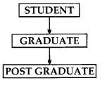
Weekly Assignment
Q5. Consider the figure given below and answer the questions that follows:
Name the base class and the derived class.
Which concept of OOP is implemented in the figure given above?

Slide 54
Old Question Papers
Q1. Predict the output of the following program. Also state which concept of OOP is being implemented?
def sum(x,y,z):
print “sum= ”, x+y+z
def sum(a,b):
print “sum= ”, a+b
sum(10,20)
sum(10,20,30)
Q2. Write a program that uses an area() function for the calculation of area of a triangle or a rectangle or a square. Number of sides (3, 2 or 1) suggest the shape for which the area is to be calculated.

Slide 55
Old Question Papers
Q3. Give a suitable example using Python code to illustrate single level inheritance considering COUNTRY to be BASE class and STATE to be derived class.
Q4. What is the difference between Multilevel inheritance and multiple inheritance? Give suitable examples to illustrate.
Q5. What are the different ways of overriding function call in derived class of python? Illustrate with example.

Slide 56
Expected Questions for University Exam
Q1.What is the need of object-oriented systems? Explain with the help of classes and objects.
Q2. What is Inheritance? How code reusability is achieved using inheritance? Explain with the help of a program.
Q3. Write short note on hybrid inheritance.
Q4. What is the difference between Multilevel inheritance and multiple inheritance? Give suitable examples to illustrate.

Slide 57
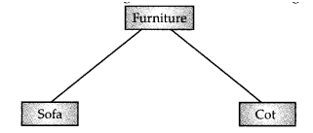
Expected Questions for University Exam
Q5. Based on the diagram, answer the following:
Write the name of the base class and the derived classes.
Write the type of inheritance depicted in the above diagram.

Slide 58
SUMMARY
Inheritance allows us to define a class that inherits all the methods and properties from another class. Parent class is the class being inherited from, also called base class.

Slide 59
Duck Typing
Duck typing is a concept related to dynamic typing, where the type or the class of an object is less important than the methods it defines.
For example, you can call len() on any Python object that defines a .__len__() method
Python follows the EAFP (Easier to Ask Forgiveness than Permission) rather than the LBLY (Look Before You Leap) philosophy. The EAFP is somewhat linked to the "duck typing" style.
The main reason for using duck typing is to provide support for dynamic typing in Python programming.

Slide 60
Duck Typing
Duck Typing is a concept related to Dynamic Typing, where the type or the class of an object is less important than the method it defines.
Using Duck Typing, we do not check types at all. Instead we check for the presence of a given method or attribute.
The reason behind the name is the duck test: “If it looks like a duck, swims like a duck, and quack like a duck, then it probably is a duck”.

Slide 61
Duck Typing Program
class Duck:
def quack(self):
print("Quack")
class Goose:
def quack(self):
print("Quack Quack")
class Dog:
def bark(self):
print("I just bark")
class ItQuacks:
def __init__(self, animal):
animal.quack()
ItQuacks(Duck())
ItQuacks(Goose())
ItQuacks(Dog())

Slide 62
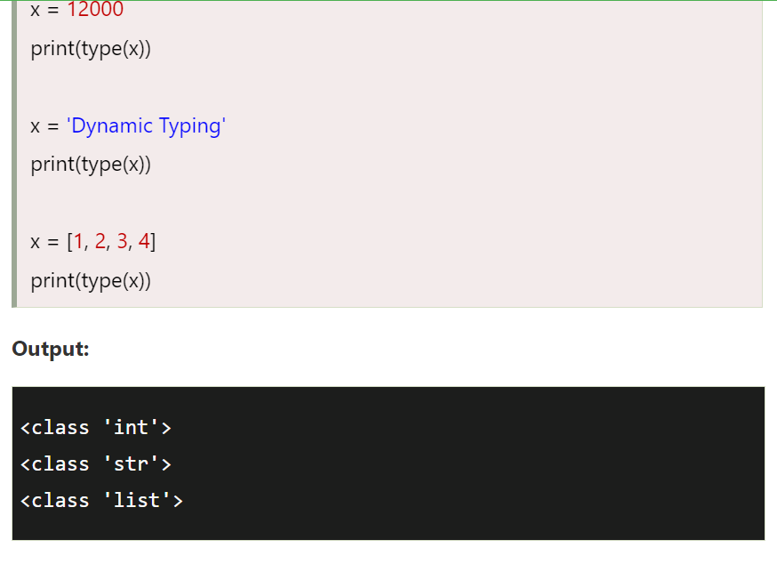
Duck Typing Program

Slide 63
Daily Quiz
1.What is the use of duck typing?
a) No restriction on the type values that can be passed to a given method
b)More restriction on the type values that can be passed to a given method
c) Less restriction on the type values that can be passed to a given method
d) Makes the program code smaller
Answer-c
2.Duck typing is static or dynamic language.
a) static b) Dynamic
Answer b

Slide 64
Python Access Modifiers
Access modifiers are used in an object-oriented programming language to limit the access of the variable and functions of a class.
Most of the object-oriented programming languages use three types of access modifiers these are public, protected, and private.
Public Access Modifier
Public members (generally methods declared in a class) are accessible from outside the class.
The object of the same class is required to invoke a public method.
This arrangement of private instance variables and public methods ensures the principle of data encapsulation.

Slide 65
Python Access Modifiers
Example of Public access Modifier
class employee:
def __init__(self, name, sal):
self.name=name
self.salary=sal
e1=Employee("Kiran",10000)
print(e1.salary) # salary is public attribute
# we can access employee class's attributes and also modify their values
e1.salary=20000
print(e1.salary)

Slide 66
Python Access Modifiers
Protected Access Modifier
Protected members of a class are accessible from within the class and are also available to its sub-classes.
No other environment is permitted access to it.
This enables the specific resources of the parent class to be inherited by the child class. By adding a prefix _(single underscore) to instance variables, we can make it protected

Slide 67
Python Access Modifiers
Example of Protected Access Modifier
class employee:
def __init__(self, name, sal):
self._name=name # name and sal are protected
self._salary=sal
e1=Employee("Kiran",10000)
print(e1._salary) # salary is protected attribute
e1._salary=20000
print(e1._salary)

Slide 68
Python Access Modifiers
Private Access Modifier
Private members of a class are denied access to the environment outside the class.
We can handle them only within the class.
By adding a prefix __(double underscore) to instance variables and functions of a class, we can make it private.

Slide 69
Python Access Modifiers
Example of Private Access Modifier
class employee:
def __init__(self, name, sal):
self.__name=name # name and sal are private
self.__salary=sal
e1=Employee("Kiran",10000)
print(e1.__salary) # salary is the private attribute
e1.__salary=20000 # Error
print(e1.__salary)
Note: we can still access the private members outside the class. Python performs name mangling, so every member prefixed with __ is changed to _class__member. So, accessing name will then be p1._Person__name. However, this is highly unadvised.

Slide 70
Use of super() function
The super() builtin function returns a proxy object (temporary object of the superclass) that allows us to access methods of the base class.
It allows you to call methods of the superclass in your subclass.
The primary use case of this is to extend the functionality of the inherited method.
In Python, super() has two major use cases:
  Allows us to avoid using the base class name explicitly
  Working with Multiple Inheritance
In the case of single inheritance, it allows us to refer base class by super()
In a class hierarchy with single inheritance, super can be used to refer to parent classes without naming them explicitly, thus making the code more maintainable

Slide 71
Without super()
Example:
class Rectangle:
def __init__(self, length, width):
self.length = length
self.width = width
def area(self):
return self.length * self.width
def perimeter(self):
return 2 * self.length + 2 * self.width
class Square:
def __init__(self, length):
self.length = length
def area(self):
return self.length * self.length
def perimeter(self):
return 4 * self.length
square = Square(4)
>>> square.area()
16
>>> rectangle = Rectangle(2,4)
>>> rectangle.area()
8

Slide 72
Use of super() in single inheritance
Example:
class Rectangle:
def __init__(self, length, width):
self.length = length
self.width = width
def area(self):
return self.length * self.width
def perimeter(self):
return 2 * self.length + 2 * self.width
class Square(Rectangle):
def __init__(self, length): super().__init__(length, length)
square = Square(4)
>>> square.area()
16

Slide 73
Use of super() with argument in single inheritance
Example:
class Rectangle:
def __init__(self, length, width):
self.length = length
self.width = width
def area(self):
return self.length * self.width
def perimeter(self):
return 2 * self.length + 2 * self.width
class Square(Rectangle):
def __init__(self, length): super(Square,self).__init__(length, length)
class Cube(Square):
def surfacearea(self): face_area=super(Square,self).area()
return face_area*6
cube = cube(4)
>>> cube.surfacearea()
16

Slide 74
Use of super() function in multiple inheritance
  class vehicle(object):
  def __init__(self,name):
  print(name,"is vehicle")
  class fly(vehicle):
  def __init__(self,canfly):
  print(canfly,"can fly")
  super().__init__(canfly)
  class run(vehicle):
  def __init__(self,canrun):
  print(canrun,"can run")
  super().__init__(canrun)
  class both(run,fly):
  def __init__(self,name):
  super().__init__(name)
  vehicle=both("mig")
  Output:
  mig can run
  mig can fly
  mig is vehicle

Slide 75
Hybrid Inheritance (CO2)
Hybrid Inheritance combines more than one form of inheritance. It is a blend of more than one type of inheritance.
Mainly Hybrid inheritance is a combination of multiple inheritance and multilevel inheritance. The class is derived from the two classes as in the multiple inheritance. However, one of the parent classes is not the base class. It is a derived class.
It gives a rise of diamond problem in python inheritance.
The Diamond Problem:
It refers to an ambiguity that arises when two classes Class2 and Class3 inherit from a superclass Class1 and class Class4 inherits from both Class2 and Class3.

Slide 76
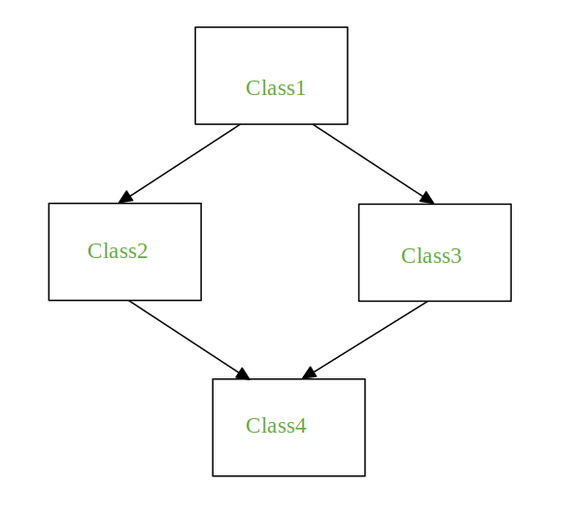
Diamond problem(CO2)
Diamond problem is a problem in multiple or hybrid inheritance..
It is a relationship exist when at least one of the parent classes can be accessed through multiple path from the bottommost class.
The bottommost class inherits the members of the base class via different path so that it creates ambiguity or create duplicate members.

Slide 77
Diamond problem(CO2)
This ambiguity must be avoided.
To prevent base classes from being accessed more than once, the dynamic algorithm linearizes the search order in such a way that the left-to right ordering specified in each class is preserved.

Slide 78
Method Resolution Order (MRO)(CO2)
In the multiple inheritance scenario members of class are searched first in the current class. If not found, the search continues into parent classes in depth-first, left to right manner without searching the same class twice(to resolve diamond problem)
Search for the child class before going to its parent class.
When a class is inherited from several classes, it searches in the order from left to right in the parent classes.
It will not visit any class more than once which means a class in the inheritance hierarchy is traversed only once exactly.

Slide 79
Method Resolution order
  The method resolution order (or MRO) tells Python how to search for inherited methods.
  This comes in case of multiple or hybrid inheritance when using super() because the MRO tells you exactly where Python will look for a method you’re calling with super() and in what order.
  Every class has an .__mro__ attribute that allows us to inspect the order.
  Example:
  both.__mro__
  Output:
  (<class '__main__.both'>, <class '__main__.run'>, <class '__main__.fly'>, <class '__main__.vehicle'>, <class 'object'>)

Slide 80
Introduction to the Specialization(CO2)
Python is used in Data Science Field.
Python is implemented in IOT Field.
Python Specialization in Artificial Intelligence tools.
The python tools is also used in web Designing ,web crawling.
Python is easily implemented in Machine Learning.
We can specialized in Python Data Science tools.
It is mostly used in Cloud Computing platform also.
The specialization of Python is storing Data.
The Specialization of Python is in Libraries of python.

Slide 81
Polymorphism(CO2)

Slide 82
Polymorphism(CO2)
Polymorphism is a word that came from two greek words, poly means many and morphs means forms.
It means that the same function name can be used for different types
Polymorphism defines the ability to take different forms.
Polymorphism in Python allows us to define methods in the child class with the same name as defined in their parent class
In Python, we have different ways to define polymorphism .Like....

Slide 83
Python Built-In Polymorphic Functions(CO2)
There are many built-in polymorphic functions in Python. As example.
# len() being used for a string
print(len("Data Science"))
# len() being used for a list
print(len([1, 2, 3, 4]))
Output:
12
4

Slide 84
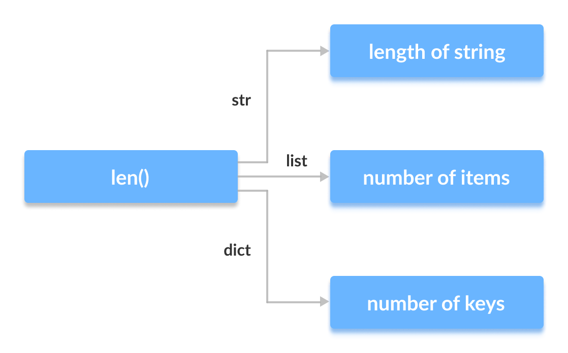
Polymorphic len() function(CO2)

Slide 85
Polymorphic Classes(CO2)
Example.
class Square:
side = 5
def calculate_area(self):
return self.side * self.side
class Triangle:
base = 5
height = 4
def calculate_area(self):
return 0.5 * self.base * self.height
sq = Square()
tri = Triangle()
print("Area of square: ", sq.calculate_area())
print("Area of triangle: ", tri.calculate_area())
Output:
Area of square: 25
Area of triangle: 10.0

Slide 86
Polymorphic using loop and functions(CO2)
Using Functions:
find_area_of_shape(obj): obj.calculate_area()
sq = Square()
tri = Triangle()
# calling the method with different objects
find_area_of_shape(sq) find_area_of_shape(tri)
:Using loop
sq = Square()
tri = Triangle()
for(obj in (sq, tri)): obj.calculate_area()

Slide 87
Ways or types of polymorphism(CO2)
There are different ways to implement polymorphism:
Method overriding
Method overloading
Operator overloading
Not supported by pyhton

Slide 88
Method overriding (CO2)
The method overriding in Python means creating two methods with the same name but differ in the programming logic.
Method overriding is a concept of object oriented programming that allows us to change the implementation of a method in the child class that is defined in the parent class.
Following conditions must be met for overriding a method:
  Inheritance should be there. Method overriding cannot be done within a class. We need to derive a child class from a parent class.
  The Method that is redefined in the child class should have the same name as in the parent class .

Slide 89
Method overriding Syntax(CO2)
# Python Method Overriding
class Employee:
def message(self):
print('This message is from Employee Class')
class Department(Employee):
def message(self):
print('This Department class is inherited from Employee')
emp = Employee()
emp.message()
print('------------')
dept = Department()
dept.message()

Slide 90
Method overriding(CO2)
Output:
This message is from Employee Class
------------
This Department class is inherited from Employee

Slide 91
Method overriding (CO2)
Write a program that has a class Polygon. Derive two classes Rectangle and
triangle from polygon and write methods to get the details of their dimensions
and hence calculate the area.

Slide 92
Operator overloading (CO2)
Operator overloading in Python is the ability of a single operator to perform more than one operation based on the class (type) of operands.
For example, the + operator can be used to add two numbers, concatenate two
strings or merge two lists. This is possible because the + operator is overloaded with int and str classes.
We can define additional methods for these operators to extend their functionality
to various new classes and this process is called Operator overloading.
Operator overloading is commonly known as Adhoc polymorphism since different operators have different implementation depending on arguments.

Slide 93
Advantage of Operator overloading (CO2)
Developer can use the same notation for user defined objects and built-in objects. For example, to add two complex number ,we can write C1 + C2
A similar level of syntactic support is provided to user –defined types as provided to the built-in types.
In scientific computing computational representation of mathematical objects is required ,operator overloading provides great ease to understand the concept.
Operator overloading makes the program clearer. For example: (c1.mul(c2)) can be written c1*c2.

Slide 94
Relational Operator and their corresponding functions (CO2)
operator | Functions
+ | __add__
- | __sub__
* | __mul__
/ | __truediv__
** | __pow__
% | __mod__
+= | __iadd__
-= | __isub__
*= | __imul__
/= | __idiv__
**= | __ipow__
%= | __imod__

Slide 95
Arithmetic Operator and their corresponding functions(CO2)
operator | Functions
> | __gt__
< | __lt__
>= | __ge__
<= | __le__
== | __eq__
!= | __ne__
Bitwise Operator and their corresponding functions
>> | __rshift__
<< | __lshift__
& | __and__
| | __or__
^ | __xor__
~ | __invert__

Slide 96
Class, methods and polymorphism

Slide 97
CONTENTS
Class Method
Concrete method
Abstract Class
Instance Method
MRO & Super()
Polymorphism
Method Overriding

Slide 98
Prerequisite and Recap(CO2)
Operators
Loop
Method
Variables
Class , Objects
Constructor

Slide 99
Topic Objectives(CO2)
After you have read and studied this topic, you should be able to
  Understand the class types and method.
  Understand how Polymorphism is done.
  Understand how method overriding is done.

Slide 100
Type of Methods(CO2)
Instance Methods
  Accessor Methods
  Mutator Methods
Class Methods
Static Methods Unit-1 Read already

Slide 101
Instance Method(CO2)
Instance methods are the methods which act upon the instance variables of the class.
Instance method need to know the memory address of the instance which is provided through self variable by default as first parameter for the instance method.
Syntax:-
def method_name(self):
function body
def method_name(self, f1, f2):
function body
Instance Method without Parameter/Formal Arguments
Instance Method with Parameter/Formal Arguments

Slide 102
Calling Instance Method w/o Argument(CO2)
Instance methods are bound to object of the class so we call instance method with object name.
Syntax:- object_name.method_name()
Ex:- realme.show_model()
class Mobile:
def show_model(self):
print(“RealMe X”)
realme = Mobile( )
realme.show_model()
Calling Instance Method w/o Argument

Slide 103
Calling Instance Method with Argument(CO2)
Syntax:- object_name.method_name(Actual_argument)
Ex:- realme.show_model(1000)
class Mobile:
def __init__(self):
self.model = ‘RealMe X’
def show_model(self, p):
self.price = p
print(self.model, self.price)
realme = Mobile( )
realme.show_model(1000)
Calling Method with argument

Slide 104
Accessor Method(CO2)
This method is used to access or read data of the variables. This method do not modify the data in the variable. This is also called as getter method.
Ex:-
def get_value(self):
def get_result(self):
def get_name(self):
def get_id(self):
class Mobile:
def __init__(self):
self.model = ‘RealMe X’
def get_model(self):
return self.model
realme = Mobile( )
m = realme.get_model()
print(m)

Slide 105
Mutator Method(CO2)
This method is used to access or read and modify data of the variables. This method modify the data in the variable. This is also called as setter method.
Ex:-
def set_value(self):
def set_result(self):
def set_name(self):
def set_id(self):
class Mobile:
def __init__(self):
self.model = ‘RealMe X’
def set_model(self):
self.model = ‘RealMe 2’
realme = Mobile( )
realme.set_model()
class Mobile:
def set_model(self, m):
self.model = m
realme = Mobile( )
realme.set_model(‘RealMe X’)

Slide 106
Class Methods(CO2)
Class methods are the methods which act upon the class variables or static variable of the class.
Decorator @classmethod need to write above the class method.
By default, the first parameter of class method is cls which refers to the class itself.
Syntax:-
@classmethod
def method_name(cls):
method body
@classmethod
def method_name(cls, f1, f2):
method body
Decorator
Class Method without Parameter/Formal Arguments
Decorator
Class Method with Parameter/Formal Arguments

Slide 107
Class Method without Parameter(CO2)
class Mobile:
@classmethod
def show_model(cls):
print(“RealMe X”)
realme = Mobile( )
class Mobile:
fp = ‘Yes’
@classmethod
def show_model(cls):
print(cls.fp)
realme = Mobile( )
Class Variable
Decorator
Decorator
Class Method
Class Method
Accessing Class variable
Inside Class Method

Slide 108
Calling Class Method without Argument(CO2)
Syntax:- Classname.method_name()
class Mobile:
@classmethod
def show_model(cls):
print(“RealMe X”)
realme = Mobile( )
Mobile.show_model()
Calling Class Method w/o Argument

Slide 109
Class Method with Parameter(CO2)
class Mobile:
fp = ‘Yes’
@classmethod
def show_model(cls, r):
cls.ram = r
print(cls.fp, cls.ram)
realme = Mobile( )
Class Variable
Defining Method with parameter
Decorator

Slide 110
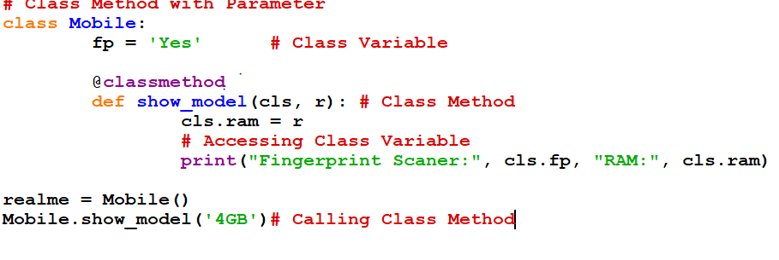
Class Method with Parameter Program(CO2)

Slide 111
Calling Class Method with Argument(CO2)
Syntax:- Classname.method_name(Actual_argument)
Ex:- Mobile.show_model(‘4GB’)
class Mobile:
fp = ‘Yes’
@classmethod
def show_model(cls, r):
cls.ram = r
print(cls.fp, cls.ram)
realme = Mobile( )
Mobile.show_model(101)
Calling Method with argument

Slide 112
Static Methods(CO2)
Static Methods are used when some processing is related to the class but does not need the class or its instances to perform any work.
We use static method when we want to pass some values from outside and perform some action in the method.
Decorator @staticmethod need to write above the static method.
Syntax:-
@staticmethod
def method_name():
method body
@staticmethod
def method_name(f1, f2):
method body
Decorator
Static Method without Parameter/Formal Arguments
Decorator
Static Method with Parameter/Formal Arguments

Slide 113
Static Method without Parameter(CO2)
class Mobile:
@staticmethod
def show_model():
print(“RealMe X”)
realme = Mobile( )
class Mobile:
fp = ‘Yes’
@staticmethod
def show_model():
print(Mobile.fp)
realme = Mobile( )
Decorator
Static Method
Static Method

Slide 114
Calling Static Method without Argument(CO2)
Syntax:- Classname.method_name()
class Mobile:
@staticmethod
def show_model():
print(“RealMe X”)
realme = Mobile( )
Mobile.show_model()
Calling Static Method w/o Argument

Slide 115
Static Method with Parameter(CO2)
class Mobile:
@staticmethod
def show_model(m, p):
model = m
price = p
print(model, price)
realme = Mobile( )
Defining Method with parameter
Decorator

Slide 116
Daily MCQs
1. To create a class, use the keyword?
A. new
B. except
C. class
D. Object
Answer: C
2. ___is used to create an object.
A. class
B. constructor
C. user-defined functions
D. In-built functions
Answer: B
3. _____ represents an entity in the real world with its identity and behavior.
A. A method
B. An object
C. A class
D. An operator
Answer:B

Slide 117
Daily MCQs
4. Special methods need to be explicitly called during object creation.
A. TRUE
B. FALSE
Answer: B
5. Overriding means changing behaviour of methods of derived class methods in the base class.
A. TRUE
B. FALSE
Answer: B
6. Which of the following is not a class method?
A. Non-static
B. Static
C. Bounded
D. Unbounded
Answer:A

Slide 118
Abstract Class(CO2)
A class derived from ABC class which belongs to abc module, is known as abstract class in Python.
ABC Class is known as Meta Class which means a class that defines the behavior of other classes. So we can say, Meta Class ABC defines that the class which is derived from it becomes an abstract class.
Abstract Class can have abstract method and concrete methods.
Abstract Class needs to be extended and its method implemented.
PVM can not create objects of an abstract class.

Slide 119
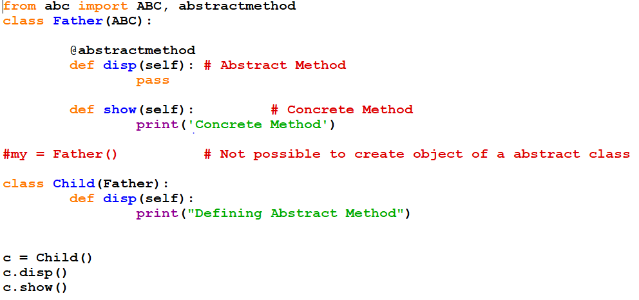
Abstract Class Program(CO2)

Slide 120
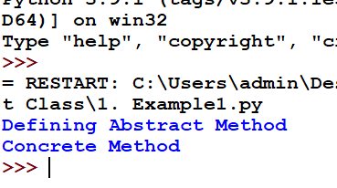
Abstract Class Program(CO2)
OUTPUT

Slide 121
Abstract Method(CO2)
An abstract method is a method whose action is redefined in the child classes as per the requirement of the object.
We can declare a method as abstract method by using @abstractmethod decorator.
Ex:-
from abc import ABC, abstractmethod
Class Father(ABC):
@abstractmethod
def disp(self):
pass

Slide 122
Concrete Method(CO2)
A Concrete method is a method whose action is defined in the abstract class itself.
Ex:-
from abc import ABC, abstractmethod
Class Father(ABC):
@abstractmethod
def disp(self):
pass
def show(self):
print(“Concrete Method”)
Abstract Method / Method Without Body
Concrete Method / Method with Body

Slide 123
Rules of Abstract Class (CO2)
PVM cannot create objects of an abstract class.
It is not necessary to declare all methods abstract in an abstract class.
Abstract Class can have abstract method and concrete methods.
If there is any abstract method in a class, that class must be abstract.
The abstract methods of an abstract class must be defined in its child class/subclass.
If you are inheriting any abstract class that have abstract method, you must either provide the implementation of the method or make this class abstract.

Slide 124
When use Abstract Class(CO2)
We use abstract class when there are some common feature shared by all the objects as they are.
Defence Force
Gun = AK 47
Area =
Gun is the common feature
shared by all Forces but area
is different for them.
Army
Gun = AK 47
Area = Land
Air Force
Gun = AK 47
Area = Sky
Navy
Gun = AK 47
Area = Sea

Slide 125
Daily MCQs
1. What is an abstract class?
A. An abstract class is one without any child classes.
B. An abstract class is any parent class with more than one child class.
C. An abstract class is class which cannot be instantiated, but can be a base class.
D. abstract class is another name for "base class."
Answer: C
2. Can an abstract parent class have non-abstract children?
A. No—an abstract parent must have only abstract children.
B. No—an abstract parent must have no children at all.
C. Yes—all children of an abstract parent must be non-abstract.
D. Yes—an abstract parent can have both abstract and non-abstract children.
Answer: D

Slide 126
Daily MCQs
3. Choose the option below for which instance of the class cannot be created.
Anonymous Class
Abstract Class
Nested Class
Parent Class Answer-B
4. Total instances of an abstract class that can be created?
A. 0 B. 1 C. 4 D. 8
Answer-A

Slide 127
Method Resolution Order (MRO)(CO2)
s = Son()
The search will start from Son. As the object of Son is created, the constructor of Son is called.
Son has super().__init__() inside his constructor so its parent class, the one in the left side ‘Father’ class’s constructor is called.
Father class also has super().__init__() inside his constructor so its parent ‘object’ class’s constructor is called.
Object does not have any constructor so the search will continue down to right hand side class (Mother) of object class so Mother class’s constructor is called.
As Mother class also has super().__inti__() so its parent class ‘object’ constructor is called but as object class already visited, the search will stop here.
object
Father
Mother
Son

Slide 128
Use the super() Function(CO2)
Python also has a super() function that will make the child class inherit all the methods and properties from its parent.
Example
class Student(Person):
def __init__(self, fname, lname):
super().__init__(fname, lname)
By using the super() function, you do not have to use the name of the parent element, it will automatically inherit the methods and properties from its parent.

Slide 129
Use the super() Function(CO2)
1. __________function that will make the child class inherit all the methods and properties from its parent.
A. self
B. __init__()
C. super
D. pass
Answer: C
2. What will be output for the folllowing code?
class A:
def __init__(self, x= 1):
self.x = x
class der(A):
def __init__(self,y = 2):
super().__init__()
self.y = y
def main():
obj = der()
print(obj.x, obj.y)
main()
A. Error, the syntax of the invoking method is wrong
B. The program runs fine but nothing is printed
C. 1 0
D. 1 2
Answer: D

Slide 130
Method Overriding with arguments(CO2)

Slide 131
Method Overriding with arguments(CO2)
class Employee:
def add(self, a, b):
print('The Sum of Two = ', a + b)
class Department(Employee):
def add(self, a, b, c):
print('The Sum of Three = ', a + b + c)
emp = Employee()
emp.add(10, 20)
print('------------')
dept = Department()
dept.add(50, 130, 90)

Slide 132
Method Overriding with arguments(CO2)
Output:
The Sum of Two = 30
------------
'The Sum of Three = 270

Slide 133
Method Overriding(CO2)
class Add:
def result(self, a, b):
print(“Addition:”, a+b)
class Multi(Add):
def result(self, a, b):
print(“Multiplication:”, a*b)
m = Multi()
m.result(10, 20)

Slide 134
Method with super( ) Method(CO2)
If we write method in the both classes, parent class and child class then the parent class’s method is not available to the child class.
In this case only child class’s method is accessible which means child class’s method is replacing parent class’s method.
super ( ) method is used to call parent class’s constructor or methods from the child class.
Syntax:- super().methodName()

Slide 135
Weekly Assignment
Q1.Write short notes on:
1) MRO
2) Super()
3) Abstract Class
Q2.What are the different ways of overriding function call in derived class of python? Illustrate with example.
Q3.Why use Abstract Base Classes?
Q4.How Abstract Base classes work?

Slide 136
Weekly Assignment
Q5. What is the output of following program:
class A:
def rk(self):
print(" In class A")
class B(A):
def rk(self):
print(" In class B")
r = B()
r.rk()

Slide 137
Daily MCQs
1.Which of the following represents a template, blueprint, or contract that defines objects of the same type?
a. A class
b. An object
c. A method
d. A data field
Answer: a
2.Which of the following represents a distinctly identifiable entity in the real world?
a. A class
b. An object
c. A method
d. A data field
Answer: b

Slide 138
Daily MCQs
1. Overriding means changing behaviour of methods of derived class methods in the base class.
A. True
B. False
Answer: B
2. What will be the output of the following Python code?
class A:
def __repr__(self):
return "1"
class B(A):
def __repr__(self):
return "2"
class C(B):
def __repr__(self):
return "3"
o1 = A()
o2 = B()
o3 = C()
print(obj1, obj2, obj3)
A. 1 1 1
B. 1 2 3
C. ‘1’ ‘1’ ‘1’
D. An exception is thrown
Answer: B

Slide 139
Daily Quiz
1.Which of the following best describes polymorphism?
a) Ability of a class to derive members of another class as a part of its own definition
b) Means of bundling instance variables and methods in order to restrict access to certain class members
c) Focuses on variables and passing of variables to functions
d) Allows for objects of different types and behaviour to be treated as the same general type
Answer: d
2.A class in which one or more methods are only implemented to raise an exception is called an abstract class.
a) True
b) False
Answer: a
3.Overriding means changing behaviour of methods of derived class methods in the base class.
a) True
b) False
Answer: b

Slide 140
Daily Quiz
4.What will be the output of the following Python code?
class A:
def __repr__(self):
return "1"
class B(A):
def __repr__(self):
return "2”
class C(B):
def __repr__(self):
return "3"
o1 = A()
o2 = B()
o3 = C()
print(obj1, obj2, obj3)
a) 1 1 1
b) 1 2 3
c) ‘1’ ‘1’ ‘1’
d) An exception is thrown
Answer: b

Slide 141
Old Question Papers
Q1. What is the output of following python code?
class Parent():
def __init__(self):
self.value = "Inside Parent"
def show(self):
print(self.value)
class Child(Parent):
def __init__(self):
self.value = "Inside Child"
def show(self):
print(self.value)
obj1 = Parent()
obj2 = Child()
obj1.show()
obj2.show()

Slide 142
Old Question Papers
Q2. What should be the output of calling the parent's class method inside the overridden method?
class Parent():
def show(self):
print("Inside Parent")
class Child(Parent):
def show(self):
Parent.show(self)
print("Inside Child")
obj = Child()
obj.show()

Slide 143
Old Question Papers
Q3.What is super method? Explain with example.
Q4. Explain method overriding with suitable example.
Q5.What is method resolution operator? Support your answer with suitable example.

Slide 144
Expected Questions for University Exam
Q1. Write short note on- (a) Method overriding
(b) Polymorphism
Q2. Explain method overriding with suitable example.
Q3. What is method resolution operator? Support your answer with suitable example.
Q4. Explain the concept of polymorphism by giving suitable examples.
Q5. Explain calling the parent's class method inside the overridden method .

Slide 145
SUMMARY
Polymorphism lets us define methods in the child class that have the same name as the methods in the parent class.

Slide 146
Introspection

Slide 147
CONTENTS
Introspection: Introspection types , Introspection objects
Introspection scopes, Inspect modules, Introspect tools

Slide 148
Prerequisite and Recap(CO2)
Loop
Method
Variables
Class , Objects
Constructor

Slide 149
Topic Objectives(CO2)
After you have read and studied this topic, you should be able to:
  Understand Introspection using python.
  Understand Introspection tools using python.

Slide 150
Introspection(CO2)
Introspection is an ability to determine the type of an object at runtime.
Everything in python is an object.
Every object in Python may have attributes and methods.
Introspection reveals useful information about your program’s objects.

Slide 151
Code Introspection(CO2)
Code Introspection is used for examining the classes, methods, objects, modules, keywords and get information about them so that we can utilize it.
Python, being a dynamic, object-oriented programming language, provides tremendous introspection support. Python’s support for introspection runs deep and wide throughout the language.

Slide 152
Introspection Types(CO2)
Python provides some built-in functions that are used for code introspection. These are following:
type() : This function returns the type of an object
dir() :This function return list of methods and attributes associated with that object.
str() :This function converts everything into a string
id() :This function returns a special id of an object.
isinstance(): Using this function, we can determine if a certain object is an instance of the specified class.
hasattr(): to check if it has the attribute

Slide 153
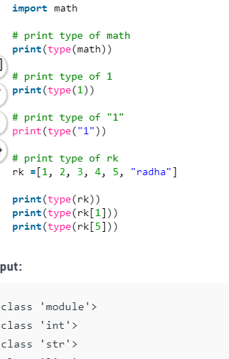
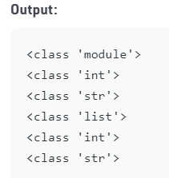
Code Introspection(CO2)
type() : This function returns the type of an object

Slide 154
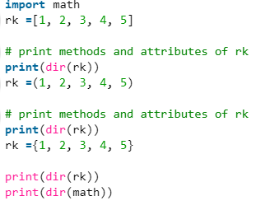
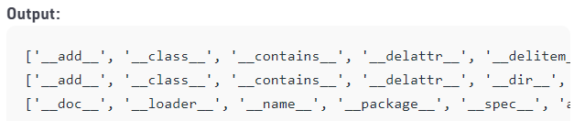
Code Introspection(CO2)
dir() :This function return list of methods and attributes associated with that object.

Slide 155
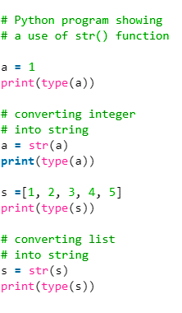
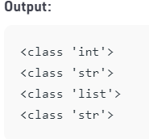
Code Introspection(CO2)
str() :This function converts everything into a string

Slide 156
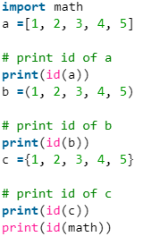
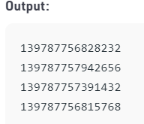
Code Introspection(CO2)
id() :This function returns a special id of an object.

Slide 157
Method Of Code Introspection(CO2)
Function | Description
help() | It is used to find what other functions do.
hasattr() | Checks if an object has an attribute.
getattr() | Returns the contents of an attribute if there are some.
repr() | Return the string representation of object.
callable() | Checks if an object has a callable object or not.
Issubclass() | Checks if a specific class is a derived class of another class.
Isinstance() | Checks if an object is an instance of a specific class.
sys() | Give access to system specific variables and functions.

Slide 158
Introspection Objects(CO2)
In computer programming, introspection is the ability to determine the type of an object at runtime.
2. It is one of Python's strengths. Everything in Python is an object and we can examine those objects:
type()
dir()
id()
getattr()
hasattr()
globals()
locals()

Slide 159
Introspection Scopes(CO2)
Python contains two built-in functions for examining the content of scopes.
The first function is globals().
This returns a dictionary which represents the global namespace.
Let’s define a variable a = 42 and call globals() again, and we can see that the binding of the name 'a' to the value of 42 has been added to the namespace.
In fact, the dictionary returned by globals() is the global namespace. Let's create a variable tau and assign value 6.283185.
We can now use this variable just like any other variables. The second function is locals().

Slide 160
Introspection Scopes(CO2)
To really see locals() in action, we're are going to create another local scope, which we can do by defining a function that accepts a single argument, defines a variable X to have a value of 496, and then prints the locals() dictionary with a width of 10 characters.
When run, we see that this function has the expected three entries in its local namespace. By using locals() to provide the dictionary, we can easily refer to local variables in format strings.

Slide 161
Inspect Module (CO2)
The inspect module helps in checking the objects present in the code that we have written.
As Python is an OOP language and all the code that is written is basically an interaction between these objects, hence the inspect module becomes very useful in inspecting certain modules or certain objects.
We can also use it to get a detailed analysis of certain function calls or tracebacks so that debugging can be easier.

Slide 162
Methods to verify the type of token(CO2)
The inspect module provides a lot of methods, these methods can be classified into two categories i.e. methods to verify the type of token and methods to retrieve the source of token.
The most commonly used methods of both categories are mentioned below.
isclass(): The isclass() method returns True if that object is a class or false otherwise.
When it combined with the getmembers() functions it shows the class and its type. It is used to inspect live classes.
ismodule(): This returns true if the given argument is an imported module.

Slide 163
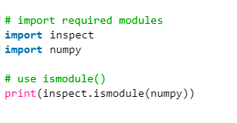
Methods to verify the type of token(CO2)
The most commonly used methods of both categories are mentioned below.
isfunction(): This method returns true if the given argument is an inbuilt function name.
ismethod(): This method is used to check if the argument passed is the name of a method or not.
o/p---True

Slide 164
Methods to retrieve the source of token(CO2)
getclasstree(): The getclasstree() method will help in getting and inspecting class hierarchy. It returns a tuple of that class and that of its preceding base classes. That combined with the getmro() method which returns the base classes helps in understanding the class hierarchy.
getmembers(): This method returns the member functions present in the module passed as an argument of this method.
stack(): This method helps in examining the interpreter stack or the order in which functions were called.

Slide 165
Methods to retrieve the source of token(CO2)
getsource(): This method returns the source code of a module, class, method, or a function passes as an argument of getsource() method.
getmodule(): This method returns the module name of a particular object pass as an argument in this method.
getdoc(): The getdoc() method returns the documentation of the argument in this method as a string.
signature(): The signature() method helps the user in understanding the attributes which are to be passed on to a function.

Slide 166
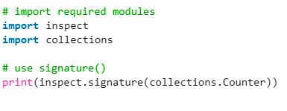
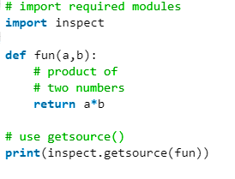
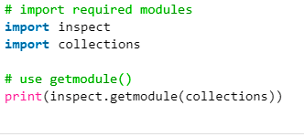
Program of Inspect(CO2)

Slide 167
Introspect Tools(CO2)
We'll now build a tool to introspect objects by leveraging the interesting techniques we've discussed and bring them together into a useful program.
Our objective is to create a function, which when passed a single object prints out a nicely formatted dump of that object's attributes with rather more clarity.
This is a small tool that we are going to create and the main use case of this tool is to help us identify a different aspect of the objects with respect to its type, methods, attributes, and documentation.

Slide 168
Weekly Assignment
Q1. Python provides some built-in functions that are used for code introspection. Explain them with examples.
Q2. Write short note on following functions:
Type()
Dir()
Str()
Q3. What are methods of code introspection? Explain.
Q4. What does isinstance() and issubclass() describes?
Q5. What does getattr() and hasattr() method are used for?

Slide 169
MCQs
1. Which is not introspection method?
a) help()
b) sys()
c) repr()
d) remove()
Answer: d
2.Which of the following is not an introspection object?
a) type()
b) id()
c) dir()
d) Unbounded()
Answer: d
3.Special methods need to be explicitly called during object creation.
a) True
b) False
Answer: b

Slide 170
MCQs
4. The Python interpreter is very open to introspection. You can examine and modify many aspects of the Python runtime environment. Which of the following modules is used to retrieve information about Python runtime?
a) system
b) runtime
c) sys
d)env
Ans: c

Slide 171
Daily Quiz
1. Is the following Python code valid?
class B(object):
def first(self):
print("First method called")
def second():
print("Second method called")
ob = B()
B.first(ob)
a) It isn’t as the object declaration isn’t right
b) It isn’t as there isn’t any __init__ method for initializing class members
c) Yes, this method of calling is called unbounded method call
d) Yes, this method of calling is called bounded method call
Answer: c

Slide 172
Old Question Papers
Q1. In the following program find out which objects are callable.
Callable.py
class Car(object):
def setName(self, name):
self.name = name
def fun():
pass
c = Car()
print(callable(fun))
print(callable(c.setName))
print(callable([]))
print(callable(1))
Q2. Explain various methods used for introspection in python.
Q3.What does callable() describes?

Slide 173
Old Question Papers
Q4. Explain various ways of inspecting Python objects.
Q5. What should be the output of the following program?
# subclass.py
class Object(object):
def __init__(self):
pass
class Wall(Object):
def __init__(self):
pass
print(issubclass(Object, Object))
print(issubclass(Object, Wall))
print(issubclass(Wall, Object))
print(issubclass(Wall, Wall))

Slide 174
Expected Questions for University Exam
Q1.What does callable() describes?
Q2. Explain various ways of inspecting Python objects.
Q3. What are introspection tools? Explain them briefly.
Q4. Explain with example issubclass() and getattr() functions.
Q5. Explain inspect modules with example.
Q6. What should be the output of the following program?
class Object(object):
def __init__(self):
pass
class Wall(Object):
def __init__(self):
pass
print(issubclass(Object, Object))
print(issubclass(Object, Wall))
print(issubclass(Wall, Object))
print(issubclass(Wall, Wall))

Slide 175
Video Links/You Tube Links
  https://www.python-course.eu/python3_inheritance.php
  https://www.youtube.com/watch?v=u9x475OGj_U
  https://www.youtube.com/watch?v=byHcYRpMgI4
  https://www.youtube.com/watch?v=FsAPt_9Bf3U

Slide 176
TEXT & REFERENCE BOOKS
Text books:
(1) Magnus Lie Hetland, "Beginning Python-From Novice to Professional"—Third Edition, Apress
(2) Peter Morgan, Data Analysis from Scratch with Python, AI Sciences
(3) Allen B. Downey, “Think Python: How to Think Like a Computer Scientist”, 2nd edition, Updated for Python 3, Shroff/O‘Reilly Publishers, 2016
(4) Miguel Grinberg, Developing Web applications with python, OREILLY
Reference Books:
(1) Dusty Phillips, Python 3 Object-oriented Programming - Second Edition, O’Reilly
(2) Burkhard Meier, Python GUI Programming Cookbook - Third , Packt
(3) DOUG HELLMANN, THE PYTHON 3 STANDARD LIBRARY BY EXAMPLE, :Pyth 3 Stan Libr Exam _2 (Developer's Library) 1st Edition, Kindle Edition.
(4) Kenneth A. Lambert, ―Fundamentals of Python: First Programs‖, CENGAGE Learning, 2012.

Slide 177
SUMMARY
Introspection is an ability to determine the type of an object at runtime. Everything in python is an object. Every object in Python may have attributes and methods.

Slide 178
THANK YOU

